Slide 1

Fasttag Fraud Detection
Name : jeyasuriya
Batch : MIP-ML-07
Notes:
:

Slide 2
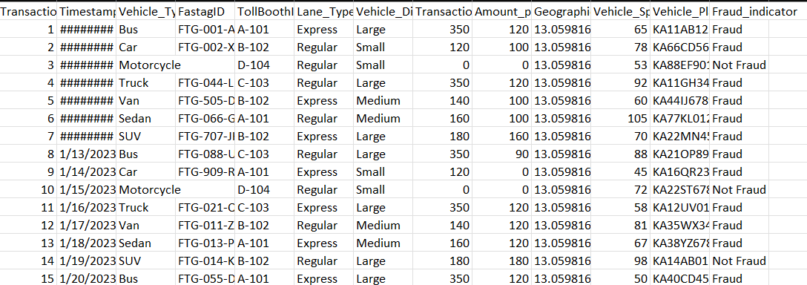
Fast tag fraud detection in data science refers to swiftly identifying and stopping fraudulent activities within electronic toll collection systems, leveraging machine learning to detect irregularities and prevent financial losses. Import Data set

Slide 3
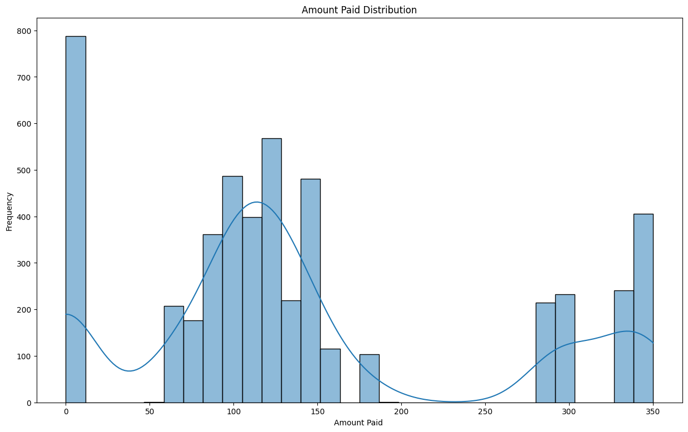
Checking the amount paid

Slide 4
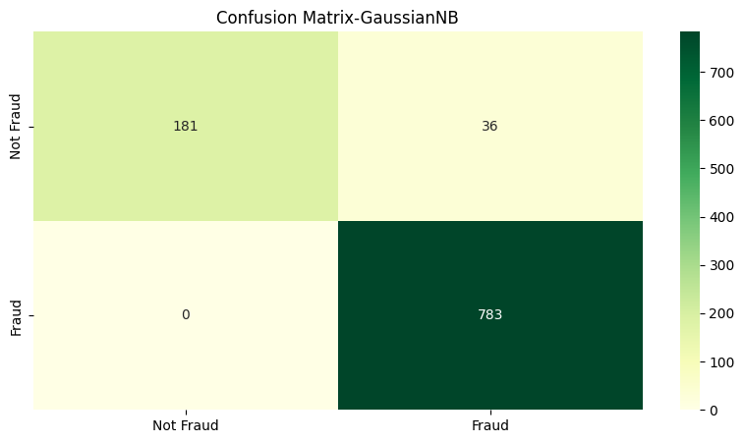
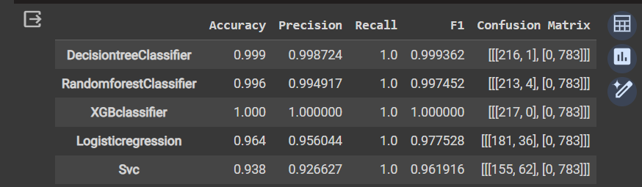
Finally I did Model buildings and calculate F1 score and Accuracy ,Precision , Recall.

